Slide 1
Database Models
Dr. Anish Soni
Assistant Professor

Slide 2
What is a Data Model?
Data model is a collection of conceptual tools for describing data, data relationships, data semantics and consistency constraints.
That means a data model provides a way to describe the design of a database.
Data models are widely used in database management systems to demonstrate how data is related, stored, retrieved, and modified.
We depict information using a set of symbols and terminology so that members of an organisation may understand and comprehend it before communicating

Slide 3
Types of Database Models
Hierarchical Model
Network Model
Entity-Relationship Model
Relational Model
Object Oriented Model

Slide 4
Hierarchical Model
The hierarchical model classifies the data into a tree-like structure with a single parent or root for each record.
Sibling records are arranged in a certain sequence.
This is the physical order in which the database is stored. Hierarchy starts from the Root Data and expands like a tree adding child nodes to the parent nodes.
This model is useful for explaining a wide range of real-world interactions

Slide 5
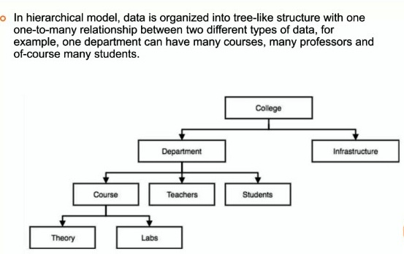
Hierarchical Model Cont..

Slide 6
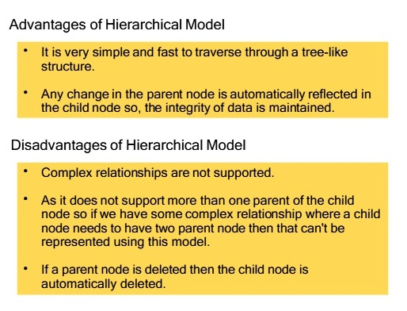
Hierarchical Model Cont..

Slide 7
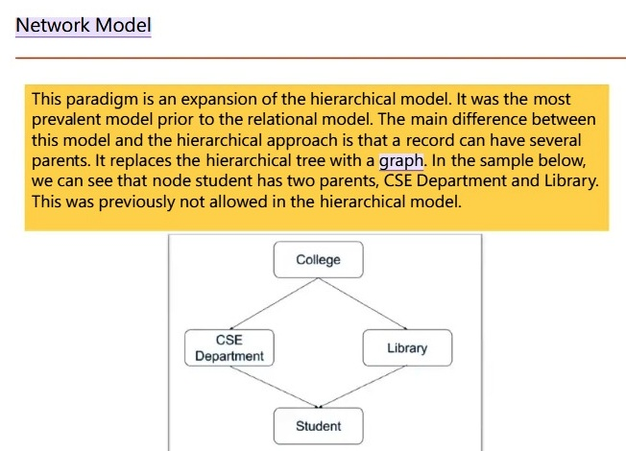

Slide 8
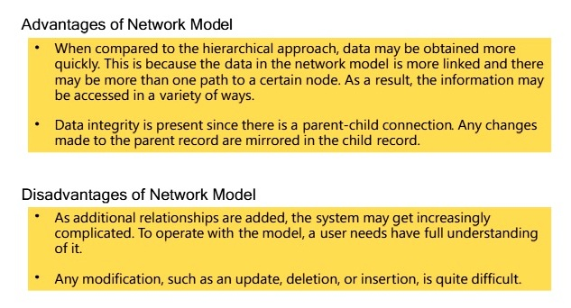

Slide 9
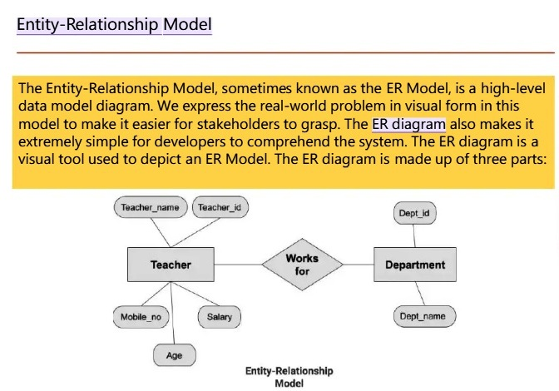

Slide 10
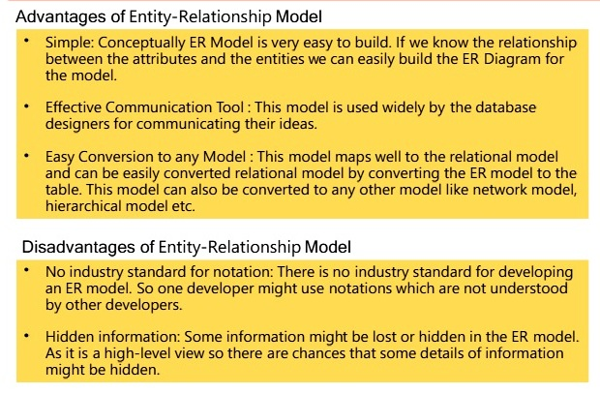

Slide 11
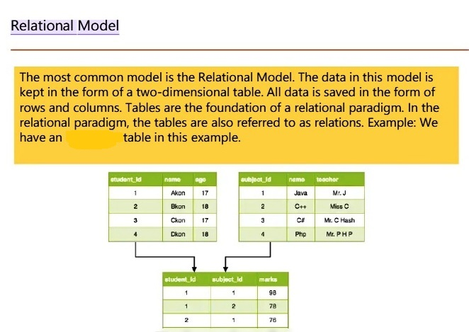

Slide 12
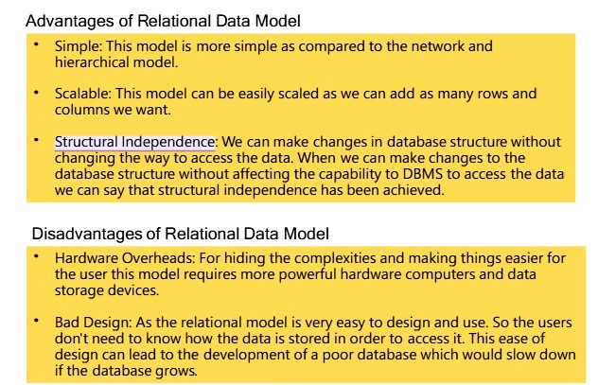

Slide 13
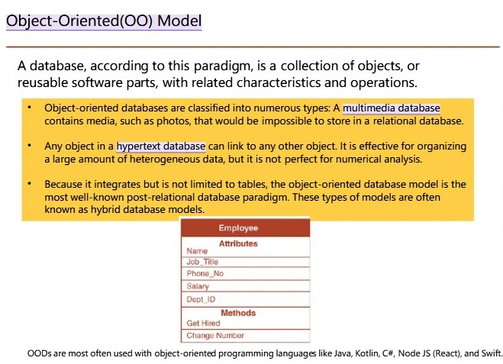

Slide 14
