Slide 1
NORMALIZATION IN DBMS
Dr. Anish Soni

Slide 2
What is Normalization?
A systematic technique for organizing relational data
Normalization is the process of structuring tables to reduce unnecessary data redundancy.
It decomposes large relations into smaller, logically related relations.
Goals: minimize redundancy, prevent anomalies, improve data integrity and make dependencies clear.
Normalization is based mainly on functional dependencies and candidate keys.
Important: Normalization does NOT simply mean “more tables”; every decomposition should preserve correctness.

Slide 3
Normal forms are a set of progressive rules (or design checkpoints) for relational schemas that reduce redundancy and prevent data anomalies.
Each normal form ( 1NF, 2NF, 3NF, BCNF, 4NF, 5NF ) is stricter than the previous one: meeting a higher normal form implies the lower ones are satisfied.
Benefits of using Normal Forms
Reduce duplicate data and wasted storage.
Prevent insert, update, and delete anomalies.
Improve data consistency and integrity.
Make the schema easier to maintain and evolve.

Slide 4
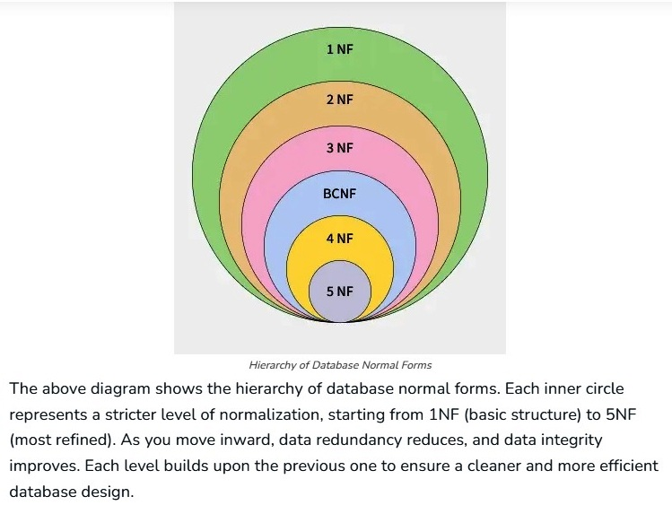

Slide 5
First Normal Form(1NF)
First Normal Form (1NF) ensures that the structure of a database table is organized in a way that makes it easier to manage and query.
A relation is in first normal form if every attribute in that relation is single-valued attribute or it does not contain any composite or multi-valued attribute.
It is the first and essential step in reduce redundancy, improve data integrity and reducing anomalies in relational database design.
A relation (table) is said to be in First Normal Form (1NF) if:
All the attributes (columns) contain only atomic (indivisible) values.
2. Each column contains values of a single type.
3. Each record (row) is unique, meaning it can be identified by a primary key.

Slide 6
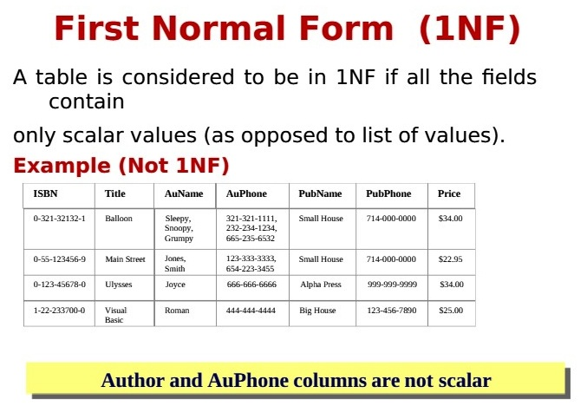

Slide 7
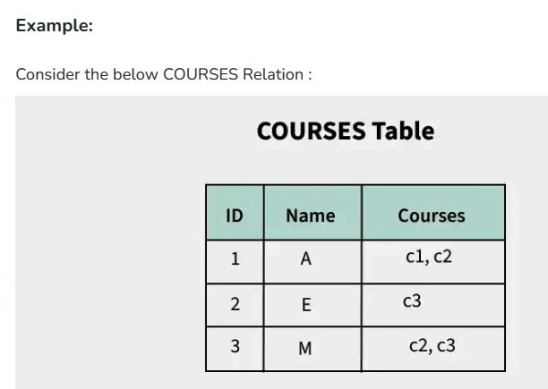
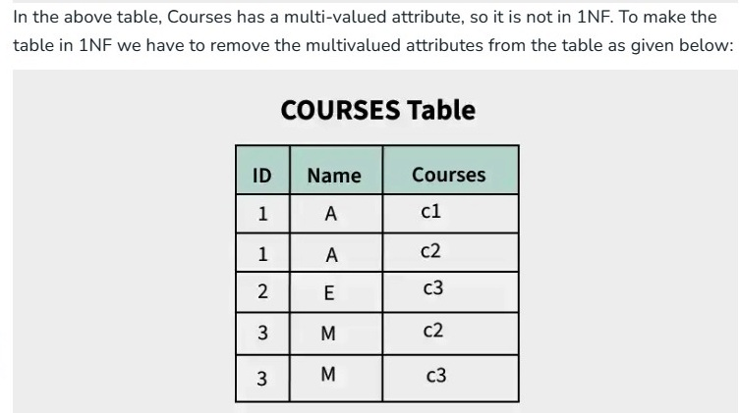
8

Slide 8
Problems in 1NF
The primary problems of leaving a database strictly in 1NF include data redundancies and the three core operational anomalies:
1. High Data Redundancy
To satisfy 1NF, multi-valued cells must be broken down by duplicating rows. If a student registers for five different courses, their non-key attributes (like name, address, and date of birth) must be repeated across five distinct rows. This causes the database size to swell unnecessarily and wastes storage space.
2. Insertion Anomalies
An insertion anomaly occurs when you cannot insert a piece of data because it is structurally dependent on another piece of data that does not exist yet.
Example: In a 1NF table tracking StudentID, StudentName, CourseID, and CourseFee, you cannot add a brand-new course to the database if no students have enrolled in it yet, because the primary key requires a valid StudentID.

Slide 9
Problems in 1NF
3. Update Anomalies
An update anomaly occurs when a single real-world change requires modifying multiple records across the database. If any row is missed, data consistency is broken.
Example: If a student changes their phone number, and their details are duplicated across ten different rows for ten different classes, you must manually run an update query across all ten rows. If the database fails mid-update, the student will have different phone numbers in different rows.
4. Deletion Anomalies
A deletion anomaly happens when deleting a record inadvertently wipes out completely unrelated, critical data from the system.
Example: If a student decides to drop out of their only registered course, deleting that row to clear their enrollment will completely erase that course's name and fee structure from the database if they were the only student taking it.

Slide 10
Second Normal Form (2NF)
Second Normal Form (2NF) is based on the concept of fully functional dependency.
It is a way to organize a database table so that it reduces redundancy and ensures data consistency.
Fully Functional Dependency means a non-key attribute depends on the entire primary key, not just part of it.
For a table to be in 2NF, it must first meet the following requirements
Meet 1NF Requirements: The table must first satisfy First Normal Form (1NF), meaning:
All columns contain single, indivisible values.
No repeating groups of columns.
2. Eliminate Partial Dependencies: A partial dependency occurs when a non-prime attribute (not part of the candidate key) depends only on a part of a composite primary key, rather than the entire key.
By ensuring these steps, a table in 2NF is more efficient and less prone to errors during updates, inserts, and deletes.

Slide 11
Second Normal Form (2NF) — Core Idea
Rule | Explanation
1NF required | The relation must already be in 1NF.
No partial dependency | Every non-prime attribute must depend on the whole candidate key.
Relevant when key is composite | If the key has one attribute, partial dependency cannot occur.
Target | Remove dependencies on only part of a composite key.
10

Slide 12
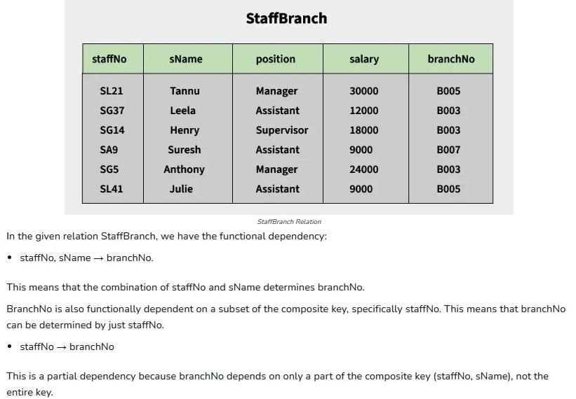
What is Partial Dependency?
In a database, a partial dependency occurs when a non-key column (i.e., not part of any candidate key) depends on only part of a composite primary key instead of the full key. This is explained in detail with the help of below given example.
11

Slide 13
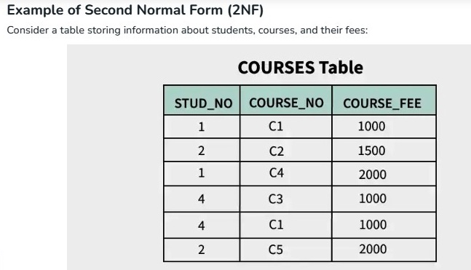
There are many courses having the same course fee. Here, COURSE_FEE cannot alone decide the value of COURSE_NO or STUD_NO.
COURSE_FEE together with STUD_NO cannot decide the value of COURSE_NO.
COURSE_FEE together with COURSE_NO cannot decide the value of STUD_NO.
The candidate key for this table is {STUD_NO, COURSE_NO} because the combination of these two columns uniquely identifies each row in the table.
COURSE_FEE is a non-prime attribute because it is not part of the candidate key {STUD_NO, COURSE_NO}.
But, COURSE_NO -> COURSE_FEE, i.e., COURSE_FEE is dependent on COURSE_NO, which is a proper subset of the candidate key.
Therefore, Non-prime attribute COURSE_FEE is dependent on a proper subset of the candidate key, which is a partial dependency and so this relation is not in 2NF.

Slide 14
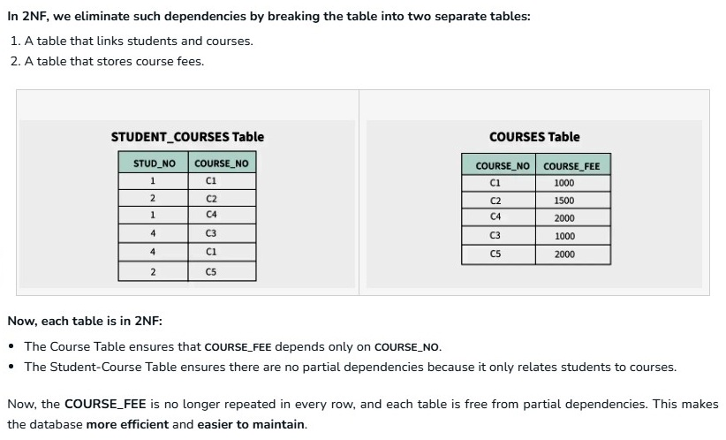

Slide 15
Problems in 2NF
While Second Normal Form (2NF) successfully eliminates partial dependencies (where a non-key column relies on only part of a composite primary key), it does not solve all database design issues.
The primary problem with a 2NF table is that it remains vulnerable to transitive dependencies
, which continue to cause data redundancy and anomalies.
A transitive dependency occurs when a non-prime attribute depends on another non-prime attribute rather than the primary key (A → B and B → C, therefore A → C).
Key Limitations and Anomalies in 2NF
Because 2NF allows transitive dependencies, it still suffers from the following issues:
1. Redundancy (Data Duplication)
Information that does not directly relate to the primary key can be repeated multiple times across rows. For example, if a table stores department information alongside employee data, the department head's name will be duplicated for every single employee working in that department.
2. Insertion Anomalies
You cannot insert certain facts into the database without creating a dummy record.
Example: If a department's details depend on a Department_ID (which depends on Employee_ID), you cannot create a new department in the system until you hire and assign at least one employee to it.

Slide 16
Problems in 2NF
3. Update Anomalies
If a piece of transitively dependent data changes, you must update multiple rows.
Example: If a department head changes, you must manually update every single employee record belonging to that department. Missing even one row leads to data inconsistency.
4. Deletion Anomalies
Deleting a record can accidentally erase unrelated, essential information.
Example: If you fire the only employee working in a specific department, deleting their row will completely wipe out that department’s existence and information from the database.

Slide 17
Third Normal Form (3NF)
The Third Normal Form (3NF) builds on the First (1NF) and Second (2NF) Normal Forms.
Achieving 3NF ensures that the database structure is free of transitive dependencies, reducing the chances of data anomalies. Even though tables in 2NF have reduced redundancy compared to 1NF, they may still encounter issues like update anomalies.
A relation is in Third Normal Form (3NF) if it satisfies the following two conditions:
It is in Second Normal Form (2NF): This means the table has no partial dependencies (i.e., no non-prime attribute is dependent on a part of a candidate key).
There is no transitive dependency for non-prime attributes: In simpler terms, no non-key attribute should depend on another non-key attribute. Instead, all non-key attributes should depend directly on the primary key.

Slide 18
Understanding Transitive Dependency
To fully grasp 3NF, it’s essential to understand transitive dependency. A transitive dependency occurs when one non-prime attribute depends on another non-prime attribute rather than depending directly on the primary key. This can create redundancy and inconsistencies in the database.
For example, if we have the following relationship between attributes:
A -> B (A determines B)
B -> C (B determines C)
This means that A indirectly determines C through B, creating a transitive dependency. 3NF eliminates these transitive dependencies to ensure that non-key attributes are directly dependent only on the primary key.

Slide 19
Conditions for a Table to be in 3NF
A table is in Third Normal Form (3NF) if, for every non-trivial functional dependency X→Y, at least one of the following holds:
X is a superkey: This means that the attribute(s) on the left-hand side of the functional dependency (X) must be a superkey (a key that uniquely identifies a tuple in the table).
Y is a prime attribute: This means that every element of the attribute set Y must be part of a candidate key (i.e., a prime attribute).

Slide 20
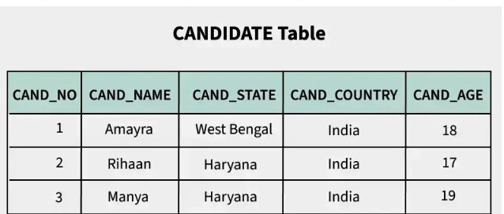
Example 1: Third Normal Form (3NF)
Consider the following relation for a Candidate table with the following attributes and functional dependencies:
1. Functional dependency Set:
The set of functional dependencies is as follows:
CAND_NO → CAND_NAME
CAND_NO → CAND_STATE
CAND_STATE → CAND_COUNTRY
CAND_NO → CAND_AGE

Slide 21
Example 1: Third Normal Form (3NF)
2. Determining the Candidate Key:
The candidate key for this relation is {CAND_NO}, since CAND_NO uniquely identifies all other attributes in the table.
3. Identifying Transitive Dependency:
The issue here arises from the transitive dependency between CAND_NO and CAND_COUNTRY:
CAND_NO → CAND_STATE
CAND_STATE → CAND_COUNTRY
This means that CAND_COUNTRY is transitively dependent on CAND_NO via CAND_STATE, which violates the Third Normal Form (3NF) rule that states that no non-prime attribute (non-key attribute) should be transitively dependent on the primary key.

Slide 22
Converting the Relation into 3NF
To remove the transitive dependency and ensure the relation is in 3NF, we decompose the original CANDIDATE relation into two separate relations:
CANDIDATE: This will store information about the candidates, including their CAND_NO, CAND_NAME, CAND_STATE, and CAND_AGE:
{CANDIDATE (CAND_NO, CAND_NAME, CAND_STATE, CAND_AGE)}
STATE_COUNTRY: This relation will store information about the states and their respective countries:
{STATE_COUNTRY (CAND_STATE, CAND_COUNTRY)}
Final Decomposed Relations:
CANDIDATE (CAND_NO, CAND_NAME, CAND_STATE, CAND_AGE)
STATE_COUNTRY (CAND_STATE, CAND_COUNTRY)

Slide 23
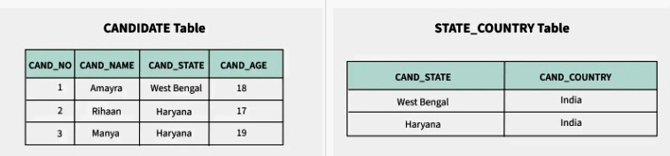
Converting the Relation into 3NF
Why This Decomposition Works:
The CANDIDATE relation now no longer has a transitive dependency. CAND_STATE no longer determines CAND_COUNTRY within this relation.
The STATE_COUNTRY relation handles the CAND_STATE → CAND_COUNTRY dependency separately, ensuring that all data is now organized in a way that satisfies 3NF.

Slide 24
1NF vs 2NF vs 3NF
Normal Form | Main condition | What it removes
1NF | Atomic values | Repeating groups / multi-valued cells
2NF | 1NF + no partial dependency | Dependency on part of composite key
3NF | 2NF + no transitive dependency | Non-key → non-key dependency
16

Slide 25
BCNF — Boyce-Codd Normal Form
Boyce-Codd Normal Form (BCNF) is an advanced version of 3NF used to reduce redundancy in databases. It ensures that for every functional dependency, the left side must be a superkey. This helps create cleaner and more consistent database designs, especially when there are multiple candidate keys.
Rules for BCNF
Rule 1: The table should be in the 3rd Normal Form.
Rule 2: X should be a super-key for every functional dependency (FD) X−>Y in a given relation.
Key Notes:
To verify BCNF, identify all determinants (left side of FDs) and check whether each is a candidate key.
2. If a relation is in BCNF, it is automatically in 3NF, 2NF, and 1NF as well.
The normal forms become stricter as we move from 1NF → 2NF → 3NF → BCNF:
1NF: Each field must hold atomic (indivisible) values.
2NF: No partial dependency on a primary key.
3NF: No transitive dependency on a primary key.
BCNF: Every determinant must be a candidate key.

Slide 26
BCNF — Boyce-Codd Normal Form
Why Do We Need BCNF?
2NF and 3NF may allow anomalies if a functional dependency exists where the determinant is not a superkey.
BCNF handles edge cases where 3NF fails to remove all redundancy, especially in tables with multiple candidate keys.
Prevents update, insert, and delete anomalies by ensuring every determinant is a superkey.
Makes database design more robust and easier to maintain over time.
Improves data consistency and clarity by removing hidden or indirect dependencies.

Slide 27
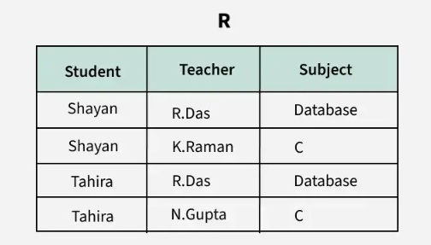
BCNF — Boyce-Codd Normal Form
Example 1
Consider a relation R with attributes (student, teacher, subject).
FD: { (student, Teacher) -> subject, (student, subject) -> Teacher, (Teacher) -> subject}
Candidate keys are (student, teacher) and (student, subject).
The above relation is in 3NF (since there is no transitive dependency). A relation R is in BCNF if for every
non-trivial FD X->Y, X must be a key.
The above relation is not in BCNF, because in the FD (teacher->subject), teacher is not a key. This relation suffers with anomalies −
For example, if we delete the student Tahira , we will also lose the information that N.Gupta teaches C. This issue occurs because the teacher is a determinant but not a candidate key.

Slide 28
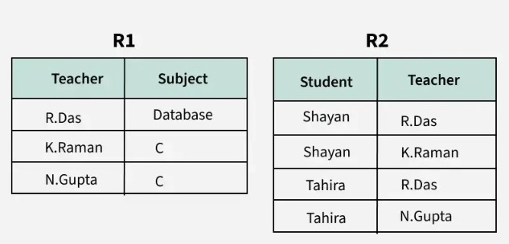
BCNF — Boyce-Codd Normal Form
BCNF is stronger than 3NF.
Formal rule: for every non-trivial FD X → Y, X must be a superkey.
3NF allows an exception when the dependent attribute is prime; BCNF does not.
BCNF is useful when a relation satisfies 3NF but still has redundancy caused by overlapping candidate keys.

Slide 29
4NF — Multivalued Dependencies
The Fourth Normal Form (4NF) is a level of database normalization where there are no non-trivial multivalued dependencies other than a candidate key. It builds on the first three normal forms (1NF, 2NF and 3NF) and the Boyce-Codd Normal Form (BCNF).
It states that, in addition to a database meeting the requirements of BCNF, it must not contain more than one multivalued dependency. It is an extension of Boyce-Codd Normal Form (BCNF) and ensures that a relation does not contain multiple independent one-to-many relationships within a single table.
The 4NF helps in eliminating multivalued dependencies from a database table. A multivalued dependency occurs when two attributes are independent of each other but depend on a third attribute. For instance, if one value in a table implies multiple rows, then there may be redundancy caused by multivalued dependencies.
Rules of 4NF
For a table to satisfy 4NF −
It must already be in Boyce-Codd Normal Form (BCNF).
The table must not have more than one multivalued dependency.

Slide 30
What is Multivalued Dependency?
If A →→ B (A multi-determines B), this means for a single value of A, there can be multiple values of B. But B is independent of any other attribute.
Example:
Student | Hobby | Language
Aman | Cricket | English
Aman | Cricket | Hindi
Aman | Music | English
Aman | Music | Hindi

Slide 31
4NF — Multivalued Dependencies
4NF addresses independent multivalued facts that create cross-product redundancy.
Multivalued dependency is written X →→ Y.
Example: a student can have multiple hobbies and multiple languages independently.
STUDENT(Student, Hobby, Language) creates combinations of every hobby with every language.
Decompose into STUDENT_HOBBY(Student, Hobby) and STUDENT_LANGUAGE(Student, Language).
Rule: for every non-trivial MVD X →→ Y, X should be a superkey.

Slide 32
5NF — Join Dependency
5NF is one of the highest levels of normalization, also known as Project-Join Normal Form (PJNF).
A table is said to be in 5NF if:
It is already in 4NF
It cannot be broken down into smaller tables without losing data
In other words, there should be no join dependency left that can cause redundancy.
The main goal of 5NF is to break down a table into the smallest possible pieces while making sure that:
You can still reconstruct the original data without loss, and
No unnecessary repetition of data occurs.

Slide 33
Lossless Join Decomposition
A decomposition is lossless if joining the decomposed relations recreates exactly the original relation.
When the table does not contain any join dependency then it is called a lossless /non-loss decomposition.
In other words, we can say that
A database is in 5NF when there is no join dependency present in the table / database.
When we decompose the given table to remove redundancy in the data and then compose it again to create the original table , we should not lose any data, and the original table should be obtained as a loss should happen after the decomposition of the table.
Join dependency for relation R can be stated as
R=(R1 ⨝ R2 ⨝ R3 ⨝ .........Rn) where R1,R2,R3.....Rn are sub-relation of R and ⨝ is Natural Join Operator.

Slide 34
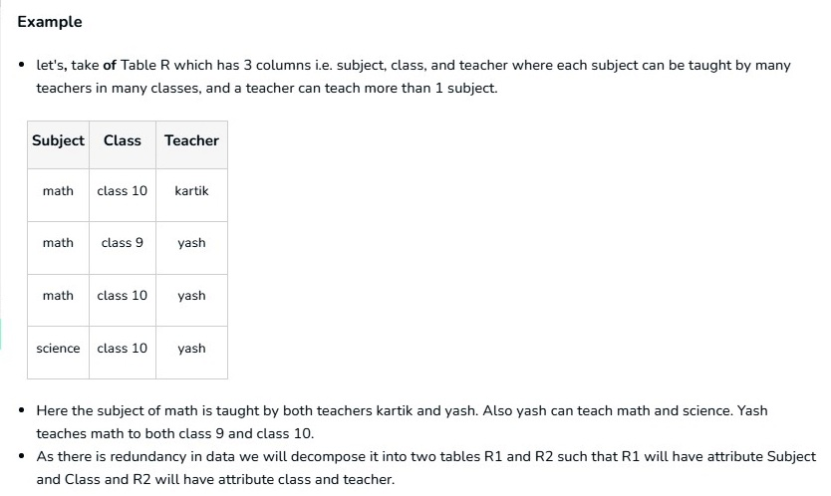

Slide 35
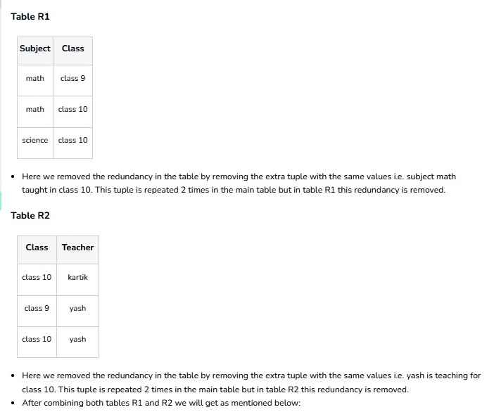

Slide 36
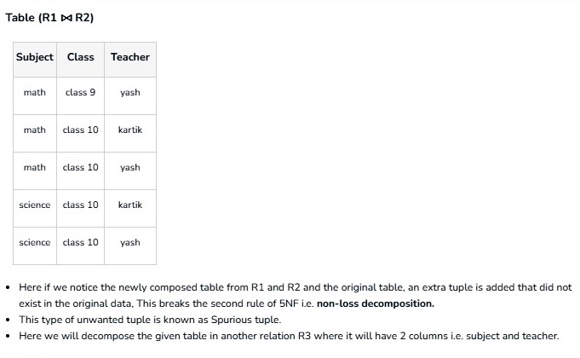

Slide 37
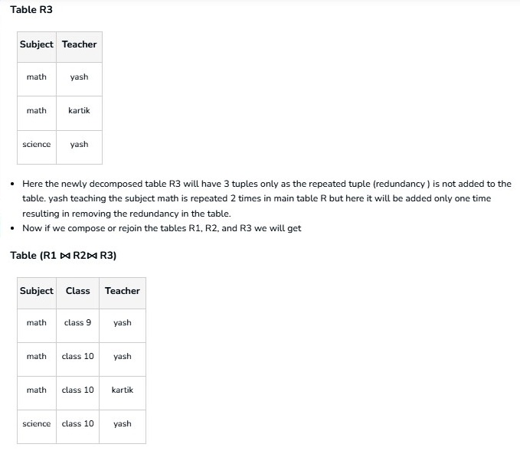

Slide 38
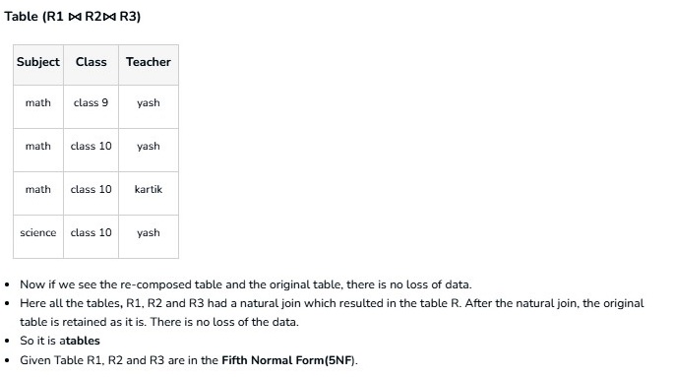

Slide 39
Complete Normalization Workflow
Step | Action
1 | Identify attributes and business rules.
2 | Find candidate keys.
3 | List functional dependencies.
4 | Convert to 1NF (atomic values).
5 | Remove partial dependencies → 2NF.
6 | Remove transitive dependencies → 3NF.
7 | Check BCNF if stronger normalization is required.
8 | Check 4NF/5NF for MVDs or join dependencies.
9 | Verify lossless join and dependency preservation.
10 | Choose practical stopping point; consider controlled denormalization if justified.
24

Slide 40
Worked Example — From Unnormalized to 3NF
UNF: ORDER(Order_ID, Customer, Customer_Phone, Product_ID, Product_Name, Qty)
1NF: one product per row; atomic values.
Assume key = {Order_ID, Product_ID}.
2NF: CUSTOMER/ORDER facts and PRODUCT facts are separated from line-item facts.
3NF: if Customer_ID → Customer_Name, Customer_Phone, store customer details in CUSTOMER.
Final design: CUSTOMER, PRODUCT, ORDERS, ORDER_ITEM.
This design stores each fact once and avoids common insertion, update and deletion anomalies.

Slide 41
Final 3NF Design — Order System
Table | Primary Key | Important attributes
CUSTOMER | Customer_ID | Customer_Name, Customer_Phone
PRODUCT | Product_ID | Product_Name, Unit_Price
ORDERS | Order_ID | Customer_ID, Order_Date
ORDER_ITEM | Order_ID + Product_ID | Qty
26

Slide 42
Advantages of Normalization
Reduces data redundancy and duplicate storage.
Improves consistency and data integrity.
Prevents or reduces insertion, update and deletion anomalies.
Makes dependencies and relationships clearer.
Easier maintenance when business facts change.
Can reduce unnecessary storage and simplify updates.
Provides a principled foundation for relational schema design.

Slide 43
Limitations & Trade-offs
More tables can mean more JOIN operations.
Highly normalized designs may make some reporting queries more complex.
Normalization does not automatically improve every query's performance.
Poorly chosen keys or missing indexes can still cause slow queries.
Real systems often use 3NF/BCNF as a design baseline and selectively denormalize for performance.
Denormalization should be deliberate, measured and protected by integrity constraints/application logic.

Slide 44
Quick Revision — Normal Forms
NF | Remember this
1NF | Atomic values; no repeating groups
2NF | 1NF + no partial dependency
3NF | 2NF + no transitive dependency
BCNF | Every determinant is a superkey
4NF | Remove problematic multivalued dependencies
5NF | Remove problematic join dependencies
29

Slide 45
KEY TAKEAWAYS
Normalization organizes data around facts and dependencies.
1NF → atomic values; 2NF → remove partial dependencies; 3NF → remove transitive dependencies.
BCNF strengthens the determinant rule; 4NF and 5NF address more advanced redundancy.
Good decomposition should be lossless and, where possible, dependency-preserving.
Normalize for integrity first; denormalize only for a justified performance or reporting need.
Thank You

