Slide 1
Anomalies in DBMS
Insertion • Update • Deletion
With simple examples
DBMS • Anomalies and Normalization

Slide 2
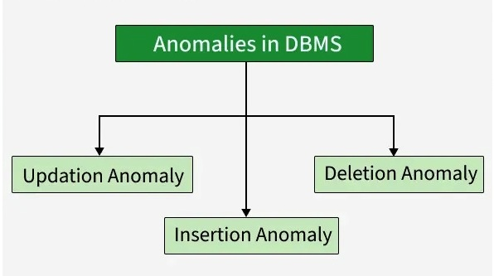
What are Database Anomalies?
Anomalies are unwanted problems that occur when data is stored in a poorly designed or redundant table.
Anomalies in DBMS are caused by poor management of storing everything in the flat database, lack of normalization, data redundancy, and improper use of primary or foreign keys.
These issues result in data inconsistency, unnecessary duplication, or accidental loss of information during insert, update, or delete operations, leading to data integrity problems.
DBMS • Anomalies and Normalization

Slide 3
Example: Poorly Designed Table
Student_ID | Student_Name | Course_ID | Course_Name | Instructor
101 | Aman | C01 | DBMS | Dr. Sharma
102 | Riya | C01 | DBMS | Dr. Sharma
103 | Karan | C02 | Operating Systems | Dr. Mehta
104 | Neha | C01 | DBMS | Dr. Sharma
Notice that course and instructor information is repeated for every student enrolled in the course.
DBMS • Anomalies and Normalization

Slide 4
1. Insertion Anomaly
Difficulty in inserting new information
An insertion anomaly occurs when we cannot add a fact to the database without adding unrelated data.
Example: A new course C03 = Computer Networks is introduced, but no student has enrolled yet.
In the poor table, Course_ID, Course_Name and Instructor are stored together with Student information.
Therefore, we may be forced to enter a fake/NULL Student_ID just to store the new course.
Result: unnecessary NULL values or incomplete records.
DBMS • Anomalies and Normalization

Slide 5
Insertion Anomaly — Example
Student_ID | Student_Name | Course_ID | Course_Name | Instructor
101 | Aman | C01 | DBMS | Dr. Sharma
102 | Riya | C01 | DBMS | Dr. Sharma
— | — | C03 | Computer Networks | Dr. Verma
The course exists even though there is no student enrolled. Student fields have to be left blank.
DBMS • Anomalies and Normalization

Slide 6
2. Update Anomaly
Same fact must be changed in multiple rows
An update anomaly occurs when the same information is stored in many rows.
Example: DBMS is taught by Dr. Sharma and appears in three rows.
If the instructor changes to Dr. Kapoor, every DBMS row must be updated.
If one row is missed, the database contains conflicting information.
This is a classic problem caused by data redundancy.
DBMS • Anomalies and Normalization

Slide 7
Update Anomaly — Example
Student_ID | Course_ID | Course_Name | Instructor
101 | C01 | DBMS | Dr. Sharma
102 | C01 | DBMS | Dr. Sharma
104 | C01 | DBMS | Dr. Sharma
Suppose the instructor changes. All three rows must be updated; missing one creates inconsistency.
DBMS • Anomalies and Normalization

Slide 8
3. Deletion Anomaly
Deleting one fact accidentally deletes another
A deletion anomaly occurs when deleting a record also removes information that we still need.
Example: Suppose Karan is the only student enrolled in C02 (Operating Systems).
If Karan's enrollment row is deleted, the course name and instructor may also disappear.
The database has unintentionally lost information about an existing course.
This happens because student and course facts are stored in the same table.
DBMS • Anomalies and Normalization

Slide 9
Deletion Anomaly — Example
Student_ID | Student_Name | Course_ID | Course_Name | Instructor
103 | Karan | C02 | Operating Systems | Dr. Mehta
Deleting Karan's row would also delete the only stored record of C02 and Dr. Mehta.
DBMS • Anomalies and Normalization

Slide 10
How Normalization Solves Anomalies
Normalization organizes data into related tables and reduces unnecessary repetition.
Instead of one large table, separate entities such as Student, Course, and Enrollment.
Student(Student_ID, Student_Name)
Course(Course_ID, Course_Name, Instructor)
Enrollment(Student_ID, Course_ID)
Primary keys uniquely identify records; foreign keys connect related tables.
This design reduces insertion, update, and deletion anomalies.
DBMS • Anomalies and Normalization

Slide 11
Normalized Design — Example
Student Table | Course Table | Enrollment Table
101 Aman | C01 DBMS / Dr. Sharma | 101 → C01
102 Riya | C02 Operating Systems / Dr. Mehta | 102 → C01
103 Karan | C03 Computer Networks / Dr. Verma | 103 → C02
104 Neha | — | 104 → C01
Course information is stored once, while Enrollment records only the relationship between students and courses.
DBMS • Anomalies and Normalization

Slide 12
Summary
Insertion anomaly → cannot insert data without unrelated information.
Update anomaly → the same data must be changed in multiple places.
Deletion anomaly → deleting one record may remove other useful information.
Main cause → poor table design and data redundancy.
Solution → normalization, appropriate primary keys, foreign keys, and well-defined relationships.
Goal: maintain consistency, reduce redundancy, and make the database easier to maintain.
DBMS • Anomalies and Normalization

Slide 13
Quick Revision
Q1. Which anomaly occurs when the same fact must be updated in many rows? → Update anomaly
Q2. Which anomaly may force us to enter NULL/unrelated data to add a new fact? → Insertion anomaly
Q3. Which anomaly can cause useful information to disappear after deletion? → Deletion anomaly
Q4. What technique is commonly used to prevent these anomalies? → Normalization
DBMS • Anomalies and Normalization

